Slide 1

DriverPass
System Analysis
Salean Rawlinson
Notes:
[No speaker notes required for this slide.]

Slide 2

System Requirements
Functional Requirements (What the system does):
User Management & Authentication: Secure account creation, authentication, and role-based access for Students, Instructors, and Administrators.
Lesson & Practice Exam Scheduling: Real-time booking, rescheduling, and automated availability tracking for driving lessons and practice tests.
Payment Integration: Secure third-party payment gateway integration for lesson deposits and full fee processing.
Non-Functional Requirements (How the system performs):
High Availability & Uptime: Target system availability to support continuous online booking without scheduling overlaps.
Performance & Responsiveness: Fast response times and web/mobile browser compatibility across devices.
Data Privacy & Security: Encrypted transmission and storage of personal records, driving credentials, and financial details.
Notes:
[In your speaker notes, include an explanation of the different requirements you determined for DriverPass’s system. What are the functional requirements you selected to describe? What are the nonfunctional requirements you selected to describe? Be sure to explain how these requirements meet DriverPass’s needs.]

Slide 3
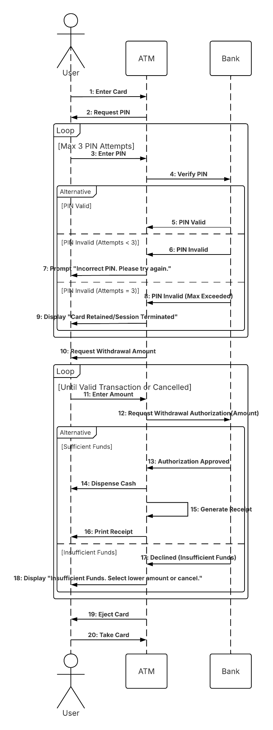
Use Case Diagram
Diagram Included: Transaction / Authentication Sequence Model
Key Components Identified:
User Interaction: User enters credentials/card and requests session authorization.
Verification Loop: System validates user credentials against backend services (up to 3 secure attempts).
Transaction Execution: System verifies account authorization/funds before confirming requested transactions and issuing confirmations/receipts.
Termination & Exception Handling: Clear prompts for invalid entries and immediate session termination upon security breaches.
Notes:
[Explain your diagram. Who are the different actors in the system? What are the different use cases? How did you account for DriverPass’s needs in your design? In your explanation, keep your audience in mind. Avoid the use of terms like “actors” and “use cases” in your explanation.]

Slide 4
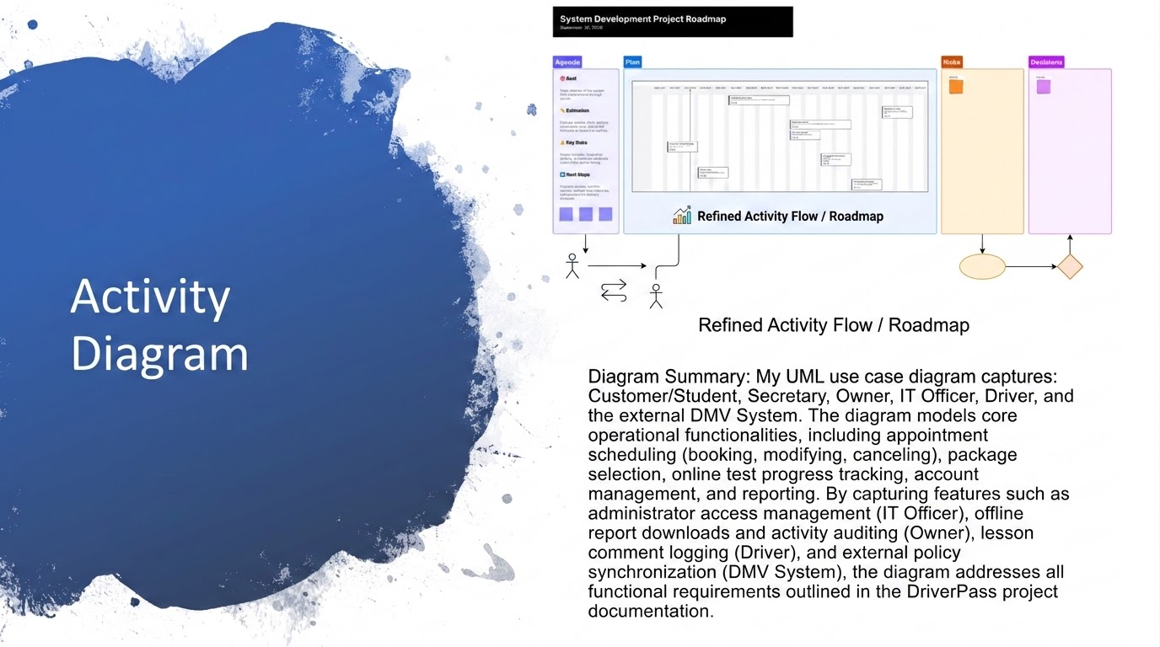
Diagram Included: DriverPass System Development Project Roadmap & Schedule
Core Execution Phases:
Requirements Gathering & Analysis: Define core system scope, BRD review, and transcript evaluation.
System & Database Design: Complete architecture, schema, process/object modeling, and UI wireframing.
Core Development: Build backend database, authentication modules, and UI screens.
Integration & Business Logic: Link interface to database, develop scheduling/payment modules, and integrate business rules.
Testing & QA: Comprehensive system testing, security/penetration checks, and User Acceptance Testing (UAT).
Deployment & Training: Server environment setup, user documentation preparation, and system launch.

Slide 5
Security
Role-Based Access Control (RBAC): Distinct permissions enforced for Students, Instructors, and Administrators to limit access to sensitive data.
Data Encryption: Industry-standard encryption applied to data in transit (TLS/SSL) and sensitive records at rest (AES-256).
Authentication Security: Secure login protocols with automated retry limits, session timeouts, and multi-factor authentication support.
Secure Payment Processing: Isolated payment gateway integrations ensuring zero local storage of full credit card numbers.
Notes:
[How did you consider security in your design? In your explanation, keep your audience in mind by avoiding the use of technical terms.]

Slide 6
System Limitations
Internet Dependency: Real-time scheduling and payment confirmation require active internet connectivity for all users.
Phase 1 Access Scope: Launch focuses on responsive web browser access (desktop, tablet, mobile), with native iOS/Android mobile apps targeted for a future phase.
Third-Party Payment Gateway Reliance: Availability for online fee processing depends on external payment service provider uptime.
Legacy Data Migration Limits: Initial rollouts require clean, standardized data imports for existing instructor and student records.
Notes:
[What are the limitations of your design? In your explanation, keep your audience in mind by avoiding the use of technical terms.]

